Slide 1
Embedded Systems Project: Sound Board/ Controller
By: Alex Mitchell

Slide 2
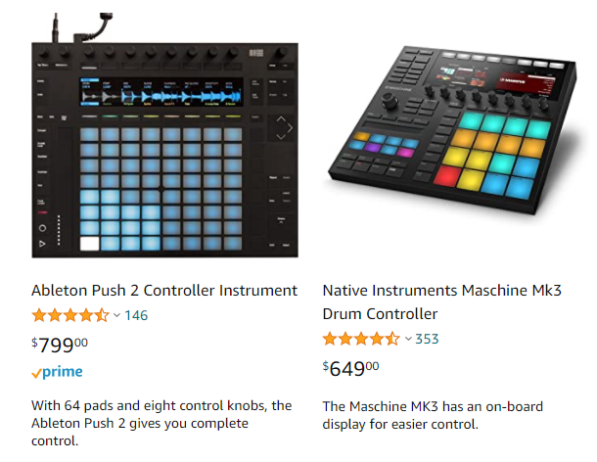
Problem Statement
Sound control boards sold on the market typically provide a large range of functionality, but this comes at a steep price. The goal of this project was to create a simpler sound board at a vastly reduced price point.
I wanted a board capable of playing sounds that were recorded live, as well as sounds that could be stored internally.

Slide 3
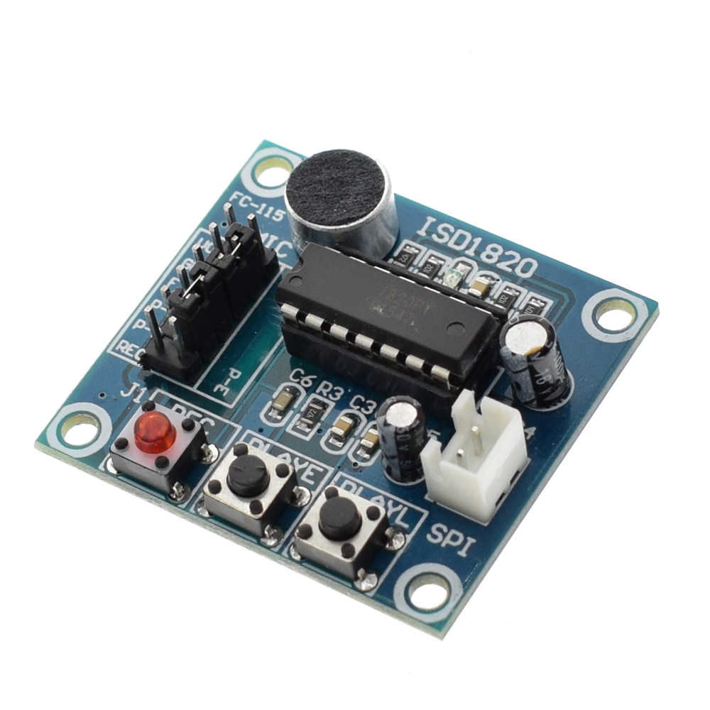
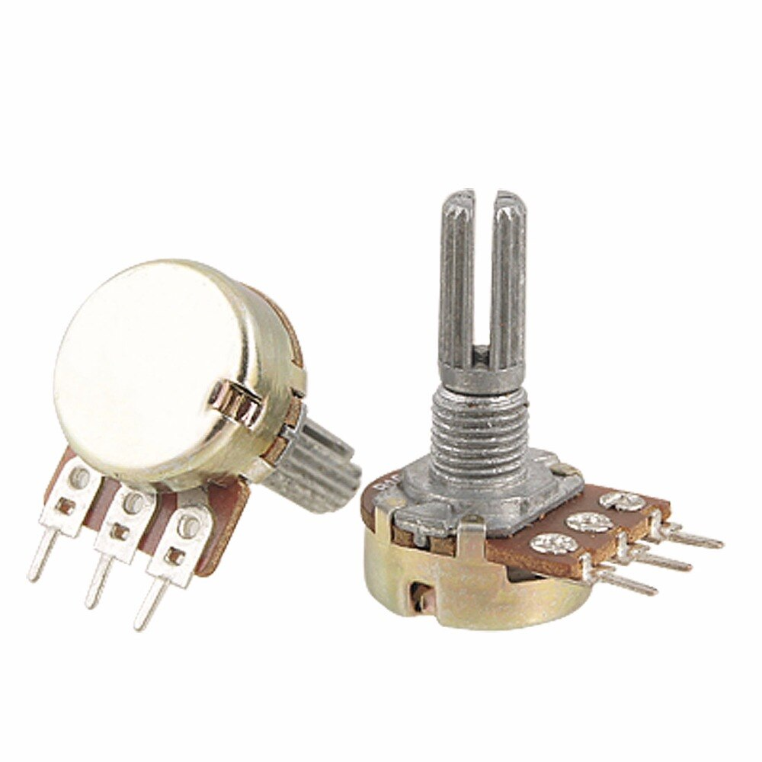
Inputs
Input 1 is sound from a microphone.
The board looks for a record button to be held in addition to a button that has a writeable space for the sound input attached to it.
Input 2 is the information gathered from the buttons and potentiometers.
The arduino takes the inputs from the buttons to play and record sounds, while using input from the potentiometers to control the lights and volume.

Slide 4
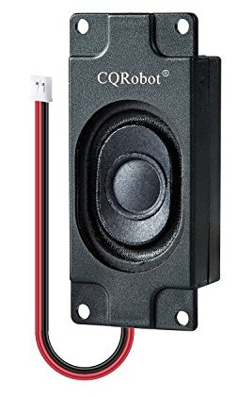
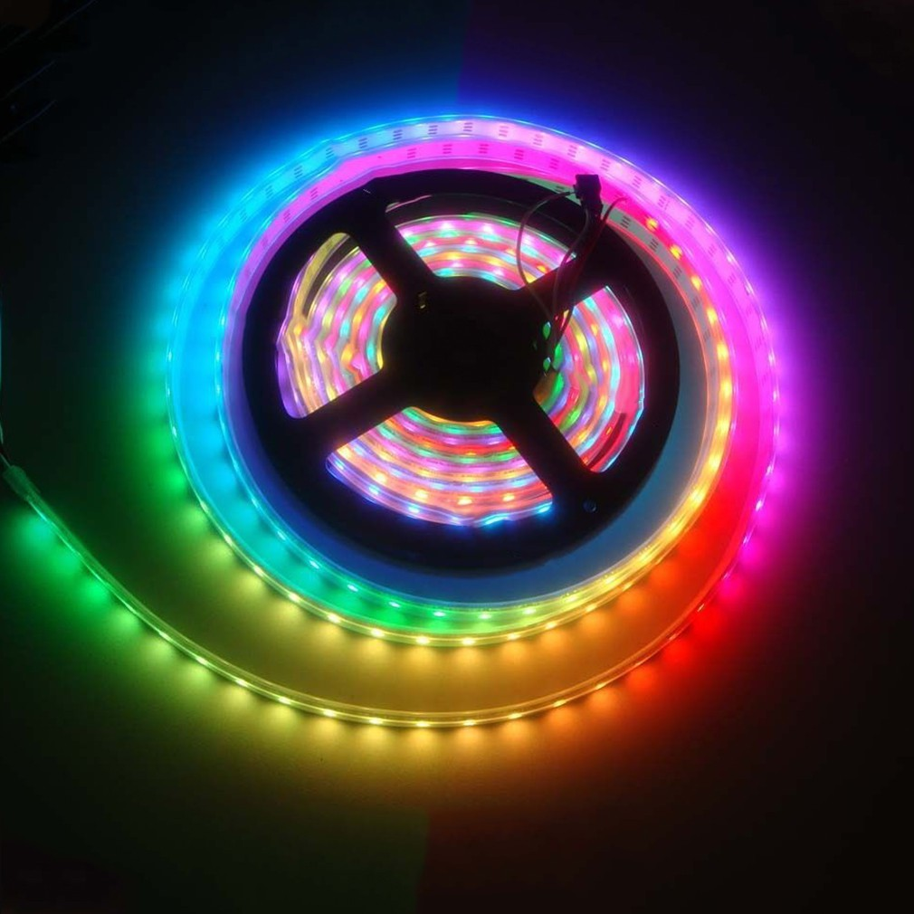
Outputs
Output 1 is sound from a speaker.
A button is pressed to play some sound that has been stored, a potentiometer allows the user to adjust the volume of what is being played.
Output 2 is in the form of a string of individually controllable LEDs.
A button is pressed to turn them on or off, while a potentiometer is used to change the colors displayed by the LEDs.

Slide 5
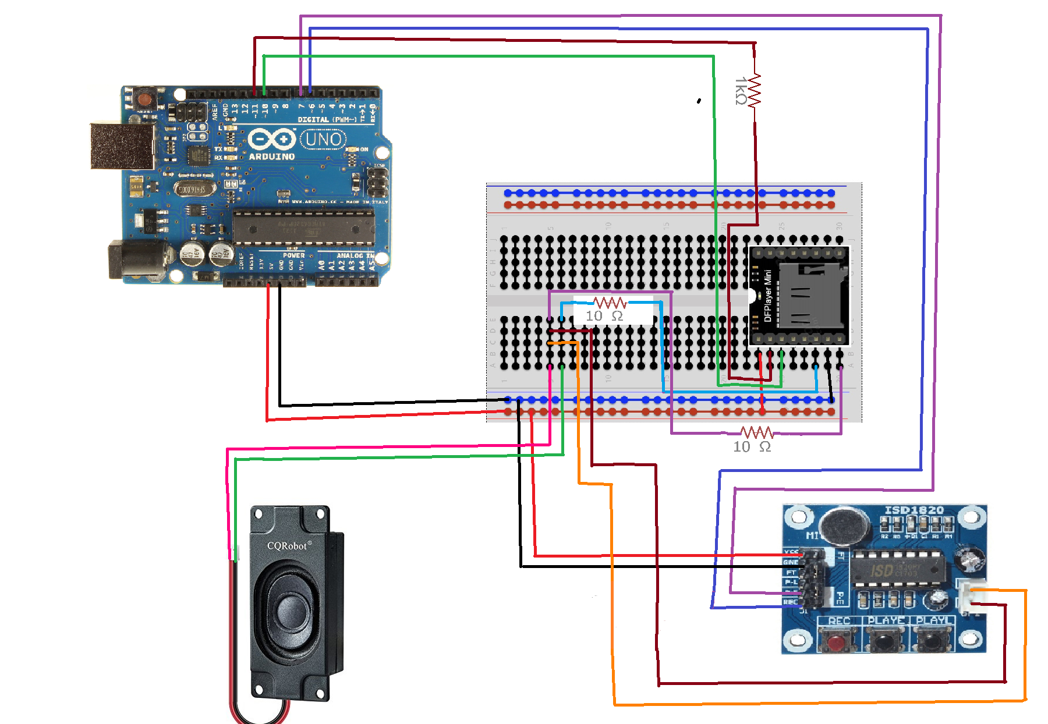
Circuits (Sound Inputs and Outputs)

Slide 6
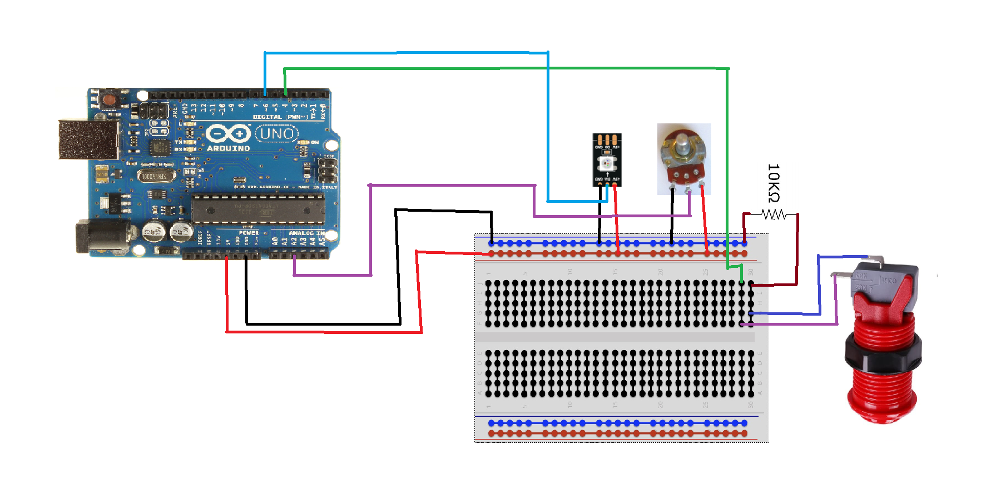
Circuits (Simple Inputs and LED strip)

Slide 7
Coding Structure (Sounds)
(If recording) Record from microphone
Wait for button press(es)
Otherwise, send recorded sound to be played
Check potentiometer for adjustments to sound
Play sound with speaker

Slide 8
Coding Structure (Lights)
Check potentiometer for adjustments
to lights
Wait for button press to turn on
Check for sound related button press
Complete light cycle and wait for button release
Continue light cycle

Slide 9
Live Demo

Slide 10
Results
I have successfully completed the project to my own liking. It can playback sounds that have been recorded live, as well as sounds that I can store within the device’s micro SD card.
System testing and verification was successful, with all parts working as intended.

Slide 11
Conclusions
I’m very glad I picked this project to complete this semester. It was something I wanted to have, so I had fun building it. Now that it’s done, the project is something that I will use and build on in the future.
Now that I have completed the project and have spent some time using it. I find that I prefer using pre-recorded sounds as opposed to live recorded ones. During future work, it’s likely that I’ll remove the recording functionality and add more functionality to the pre-recorded sounds.

